Slide 1
Smart Wireless Device
WSN- Wireless Sensor Network Technology: Range is very low, <100mm
Smart wearable devices: Smart Vest, Smart Helmet, Smart Strap.
This devices required Body Sensor Network (BSN).
LoRoWAN- Long Range Wide Area Networking is used to transmit the information.
LoRa is a wireless audio frequency technology that operates in a license-free radio frequency spectrum. LoRa is a physical layer protocol that uses spread spectrum modulation and supports long-range communication at the cost of a narrow bandwidth. It uses a narrow band waveform with a central frequency to send data, which makes it robust to interference.
Characteristics of LoRoWAN:
Long range communication up to 10 miles in line of sight.
Long battery duration of up to 10 years. For enhanced battery life, you can operate your devices in class A or class B mode, which requires increased downlink latency.
Low cost for devices and maintenance.
License-free radio spectrum but region-specific regulations apply.
Low power but has a limited payload size of 51 bytes to 241 bytes depending on the data rate. The data rate can be 0,3 Kbit/s – 27 Kbit/s data rate with a 222 maximal payload size.

Slide 2
MEMS sensors- Micro Electro Mechanical Systems.
1) It is miniature device that can be measure physical quantitate like temp, pressure, acceleration and magnetic field.
2) Made up of- micro actuators, microelectronics, micro sensors, mechanical microstructures integrated onto a single chip.
3)Much smaller than human hair, 0.02mm to 1mm.
Applications of MEMS-
Space Satellite
Launch Vehicles
Aerospace Equipment’s
Aircraft
Vehicles
Oil and Gas
Mining
Special Medical
Silicone used to make MEMS.

Slide 3
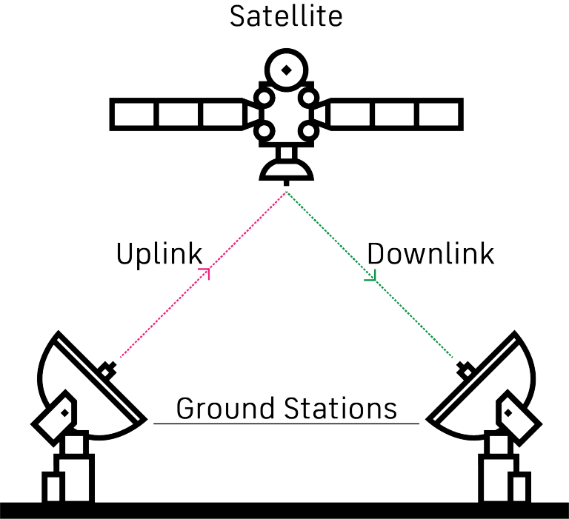
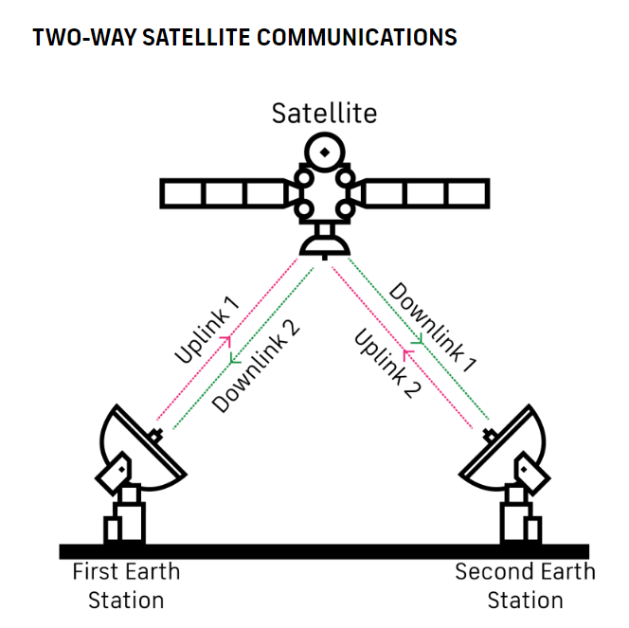
Satellite Communication:
Satellite communications use a combination of orbiting satellites above the Earth and ground stations to transmit and relay information using microwaves from one point on Earth to another.
There are three stages in the process:
Uplink
Transponder
Downlink

Slide 4
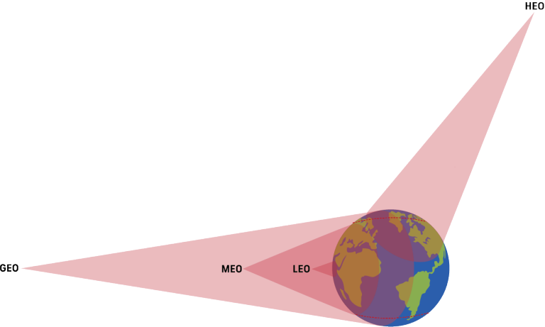
Based on the orbit, communication satellites fall into one of four categories:
Geostationary Earth orbit (GEO)
Medium Earth orbit (MEO)
Low Earth orbit (LEO)
Highly elliptical orbit (HEO)
Low Earth Orbit Satellite- Communication, Military Reconnaissance, Spying.
Geostationary Earth Orbit Satellite: Communication, TV, Radio, Satellite Phone, Weather Forecasting.

Slide 5
Temperature Sensors-
A temperature sensor is a device, typically, a thermocouple or resistance temperature detector, that provides temperature measurement in a readable form through an electrical signal.
There are many types of temperature sensors, but, the most common way to categorize them is based on the mode of connection which includes, contact and non-contact temperature sensors.
Contact sensors include thermocouples and thermistors because they are in direct contact with the object they are to measure. Whereas, the non-contact temperature sensors measure the thermal radiation released by the heat source. Such temperature meters are often used in hazardous environments like nuclear power plants or thermal power plants.
How Does Temperature Sensor Works:
The basic principle of working the temperature sensors is the voltage across the diode terminals. If the voltage increases, the temperature also rises, followed by a voltage drop between the transistor terminals of the base and emitter in a diode.
Besides this, Encardio Rite has a vibrating wire temperature sensor that works on the principle of stress change due to temperature change.

Slide 6
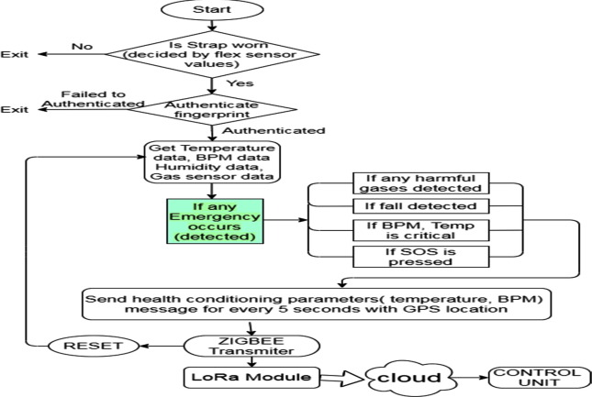

Slide 7
1) Critical Health Parameters: If the body temperature/heartbeat become critical (if it crosses the Threshold level) an alert message will be sent.
2) Fall Detection: If the soldier suddenly falls to the ground, it will be detected by an accelerometer and the alert message will be sent.
3) Surrounding Atmosphere: If any gases exceed the limits which are harmful to the soldiers and oxygen levels in the atmosphere.
4) Emergency Switch: Push-button will be used to achieve the SOS (Save Our Ship) facility.

Slide 8
Most affected area during injury
In this study we present a new approach to the design of the military personal armour system (MPAS). This approach is based on a computerized analysis of the exact anatomical location of 405 penetrating war injuries (290 shrapnel and 115 bullet injuries) in 164 soldiers killed in the Lebanon war. All the penetrating injuries (hits) were plotted on a computerized image of the human body. About 90 per cent of all hits were to the front of the body; 55 per cent of all hits were to the left side. About 45 per cent of all hits were to the torso, which is slightly more than the torso's proportion of total body-surface area (36 per cent). Of all hits to the torso, 64 per cent of the shrapnel hits and 73.3 per cent of the bullet hits were limited to the front mid torso (T4 to T9). The head at the level of the helmet received 9 per cent of all hits, most of which were over the frontal bones (72.4 per cent). The body part with the greatest density of penetrating injuries was the face, with 22.2 per cent of all penetrating wounds, and in particular the mid face, from the level of the lips to the level of the zygomatic bones, was especially vulnerable, sustaining 10 per cent of all the penetrating wounds. These findings suggest several possible modifications in the standard MPAS: an additional protective device over the front mid torso may be incorporated; the face may be protected by a transparent and lightweight face-shield; a horizontal margin added to the standard helmet may protect the upper face from missiles from above; a chin cover may protect the lower face.
waist

Slide 9
Body parameter

Slide 10
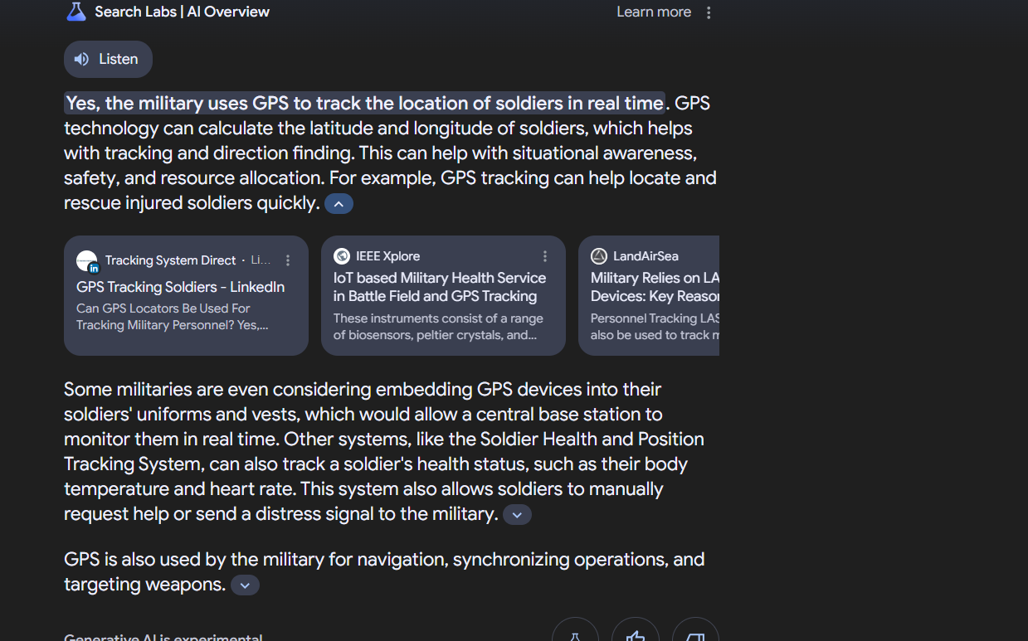

Slide 11
Sensor
Electronic wala bnda

